Slide 1
IMAGE BASED ATTENDANCE MONITORING SYSTEM
Group Number:23
1.Bhagyashree 1PE13EC024
2.Chethan Kumar TJ 1PE13EC031
3.Dhanush M Kuber 1PE12EC041
4.Mridula C 1PE13EC076
Guide: Dr. Subhash Kulkarni

Slide 2




DESIGN FLOW WITH TIMELINEFLOW WITH TIMELINE
Data base building
Literature collection
Pre processing
15/10/16
Face detection
15/12/16
Feature set
Building and
Recognition
1/2/17
Demonstration
And compilation
15/4/17
Android enabled
App building
15/3/17
Integration
and Testing
1/3/17

Slide 3
FACE RECOGNITION
Face is a complex multidimensional structure and needs good computing techniques for recognition. The face is our primary and first focus of attention in social life playing an important role in identity of individual. We can recognize a number of faces learned throughout our lifespan and identify that faces at a glance even after years. There may be variations in faces due to aging and distractions like beard, glasses or change of hairstyles.

Slide 4
FACE RECOGNITION USING EIGEN FACE BY PCA
Face is a complex multidimensional structure and needs a good computing techniques for recognition. Our approach treats face recognition as a two-dimensional recognition problem. In this scheme face recognition is done by Principal Component Analysis (PCA). Face images are projected onto a face space that encodes best variation among known face images. The face space is defined by Eigen face which are eigenvectors of the set of faces, which may not correspond to general facial features such as eyes, nose, lips. The Eigen face approach uses the PCA for recognition of the images. The system performs by projecting pre extracted face image onto a set of face space that represent significant variations among known face images. Face will be categorized as known or unknown face after matching with the present database
.

Slide 5
START
Calculate the covariance matrix
Calculate the eigenvectors and Eigenvalues of the covariance matrix
Prepare a training face database
Prepare the data set
Compute the average face vector
Subtract the average face vector from the original faces

Slide 6
Computer the Euclidean distance between test feature vector and all the training feature vectors.
Find the face class with minimum Euclidian distance which shows similarity to test image
Keep only K eigenvectors
(corresponding to K largest eigenvalues)
Calculate features weight for Training images
Read the testing face image
Calculate the feature vector of the test file
END

Slide 7
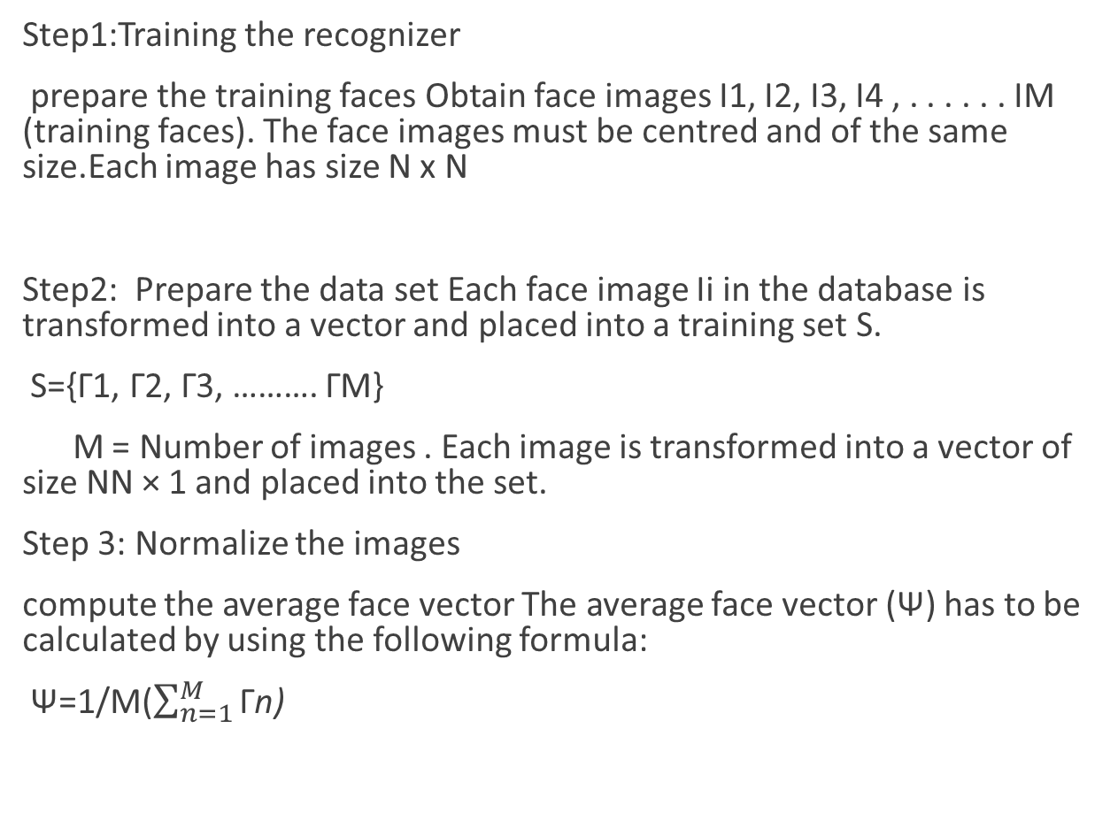
Eigenface algorithm
Step1:Training the recognizer
prepare the training faces Obtain face images I1, I2, I3, I4 , . . . . . . IM (training faces). The face images must be centred and of the same size.Each image has size N x N
Step2: Prepare the data set Each face image Ii in the database is transformed into a vector and placed into a training set S.
S={Γ1, Γ2, Γ3, ………. ΓM}
M = Number of images . Each image is transformed into a vector of size NN × 1 and placed into the set.
Step 3: Normalize the images
compute the average face vector The average face vector (Ψ) has to be calculated by using the following formula:
Ψ=1/M($\sum_{n=1}^{M}{\text{Γ}\text{n}\text{)}}$

Slide 8
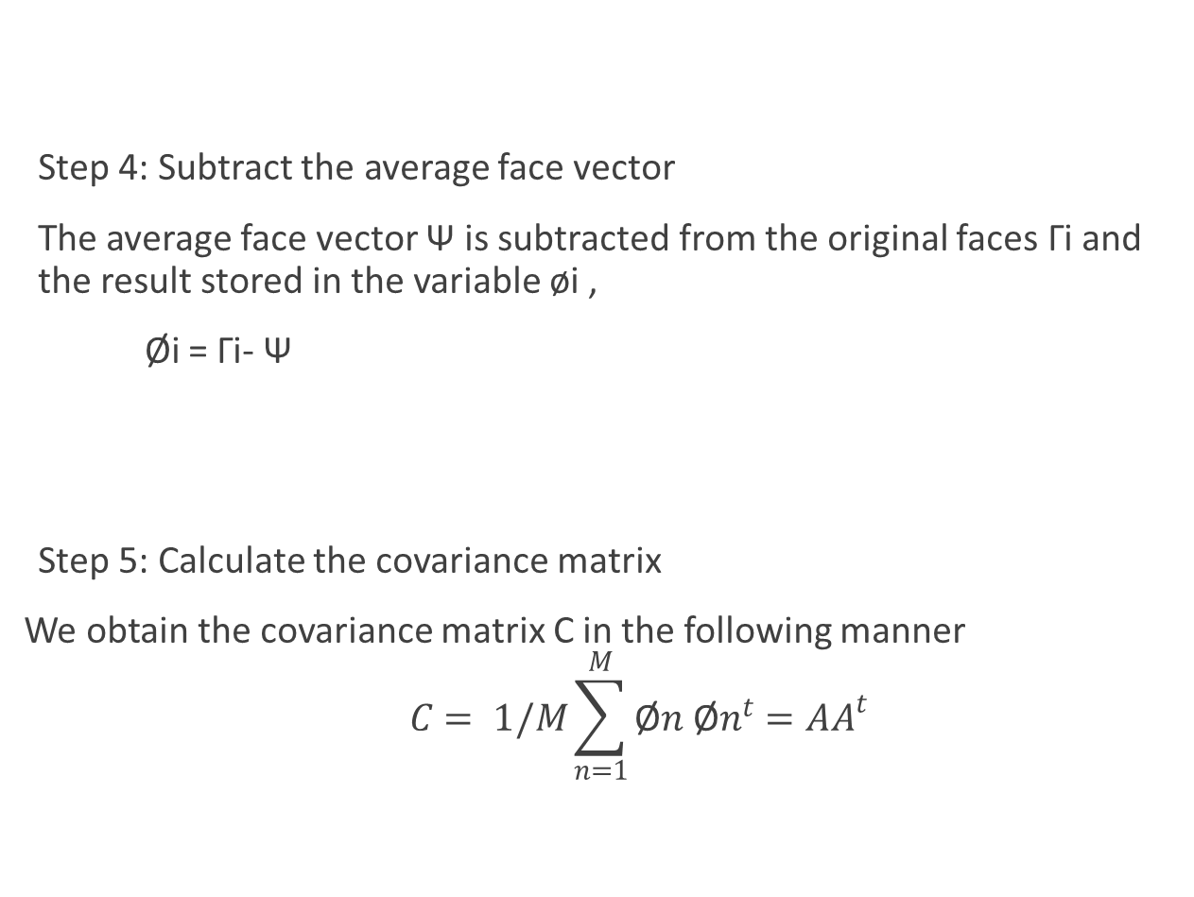
Step 4: Subtract the average face vector
The average face vector Ψ is subtracted from the original faces Γi and the result stored in the variable øi ,
Øi = Γi- Ψ
Step 5: Calculate the covariance matrix
We obtain the covariance matrix C in the following manner
$$C= 1/M\sum_{n=1}^{M}{\text{Ø}n \text{Ø}n^{t}}=AA^{t}$$

Slide 9
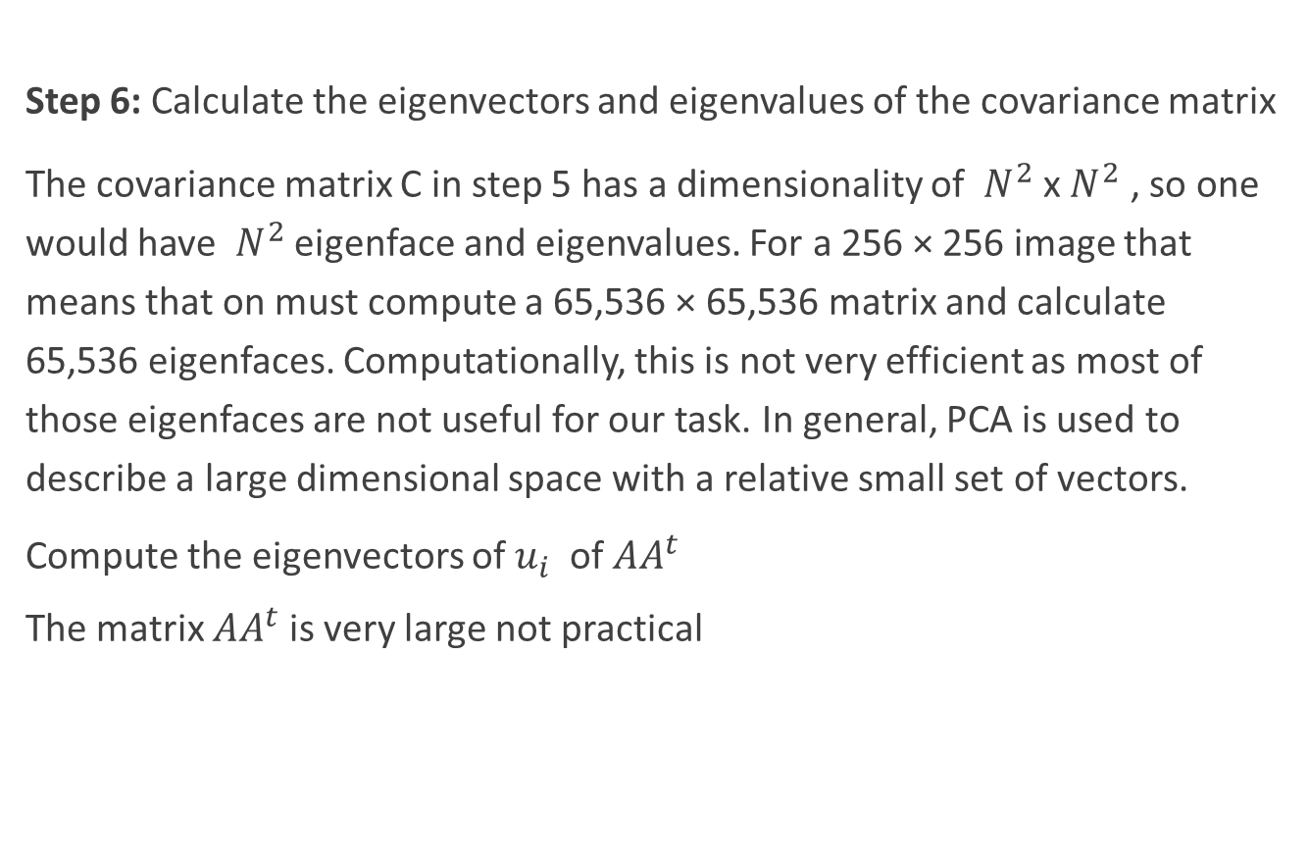
Step 6: Calculate the eigenvectors and eigenvalues of the covariance matrix
The covariance matrix C in step 5 has a dimensionality of $N^{2}$ x $N^{2}$ , so one would have $N^{2}$ eigenface and eigenvalues. For a 256 × 256 image that means that on must compute a 65,536 × 65,536 matrix and calculate 65,536 eigenfaces. Computationally, this is not very efficient as most of those eigenfaces are not useful for our task. In general, PCA is used to describe a large dimensional space with a relative small set of vectors.
Compute the eigenvectors of $u_{i}$ of ${AA}^{t}$
The matrix ${AA}^{t}$ is very large not practical

Slide 10
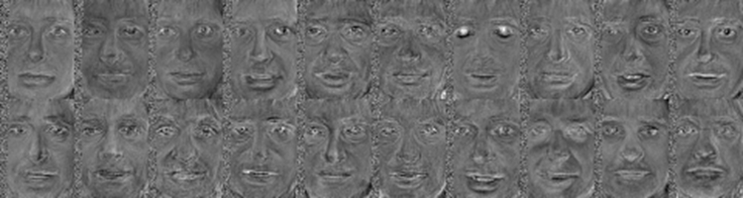
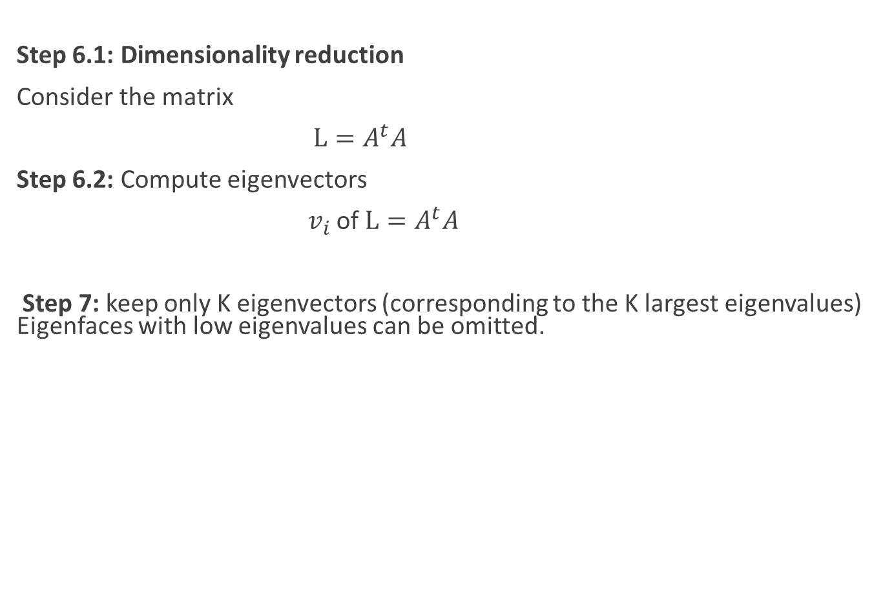
Step 6.1: Dimensionality reduction
Consider the matrix
$L=A^{t}A$
Step 6.2: Compute eigenvectors
$v_{i}$ of $L=A^{t}A$
Step 7: keep only K eigenvectors (corresponding to the K largest eigenvalues) Eigenfaces with low eigenvalues can be omitted.

Slide 11
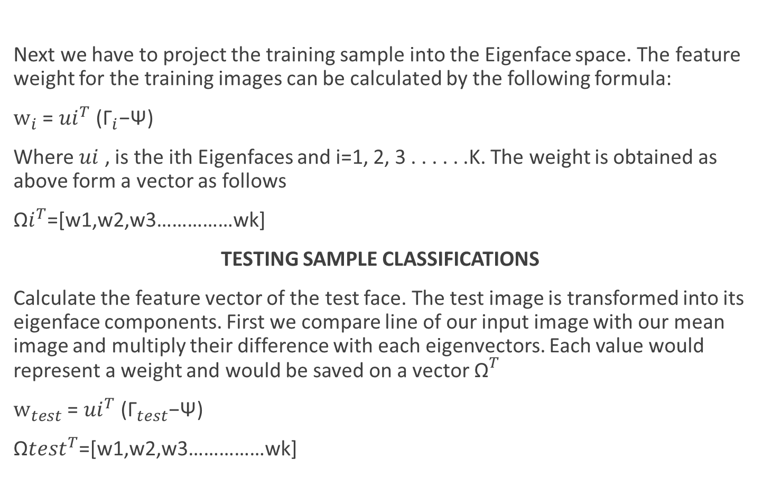
PROJECTION OF TRAINING SAMPLES INTO THE EIGENFACE SPACE
Next we have to project the training sample into the Eigenface space. The feature weight for the training images can be calculated by the following formula:
${\text{w}}_{i}$ = ${ui}^{T}$(${\text{Γ}}_{i}$−Ψ)
Where $ui$ , is the ith Eigenfaces and i=1, 2, 3 . . . . . .K. The weight is obtained as above form a vector as follows
${\text{Ω}i}^{T}$=[w1,w2,w3……………wk]
TESTING SAMPLE CLASSIFICATIONS
Calculate the feature vector of the test face. The test image is transformed into its eigenface components. First we compare line of our input image with our mean image and multiply their difference with each eigenvectors. Each value would represent a weight and would be saved on a vector ${\text{Ω}}^{T}$
${\text{w}}_{test}$ = ${ui}^{T}$(${\text{Γ}}_{test}$−Ψ)
${\text{Ω}test}^{T}$=[w1,w2,w3……………wk]

Slide 12
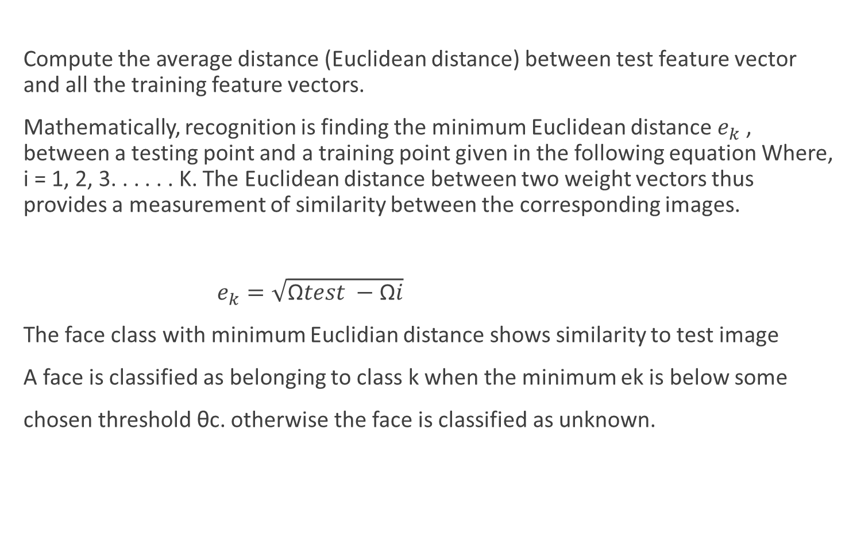
Compute the average distance (Euclidean distance) between test feature vector and all the training feature vectors.
Mathematically, recognition is finding the minimum Euclidean distance $e_{k}$ , between a testing point and a training point given in the following equation Where, i = 1, 2, 3. . . . . . K. The Euclidean distance between two weight vectors thus provides a measurement of similarity between the corresponding images.
$e_{k}=\sqrt{\text{Ω}test −\text{Ω}i}$
The face class with minimum Euclidian distance shows similarity to test image
A face is classified as belonging to class k when the minimum ek is below some
chosen threshold θc. otherwise the face is classified as unknown.

Slide 13
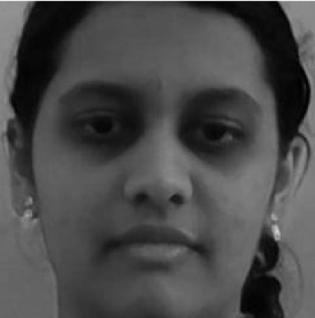
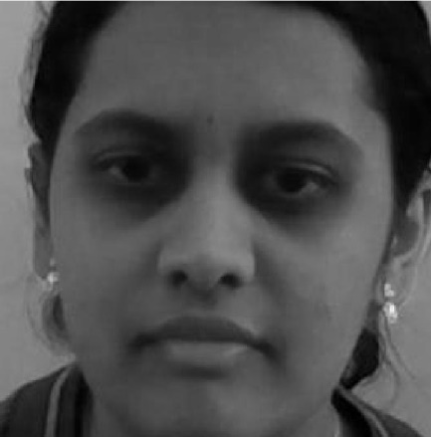
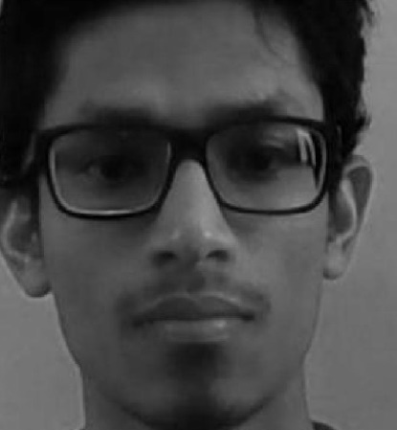
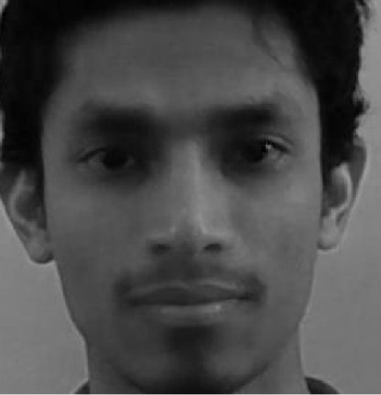
Results
test image matched image

Slide 14
Reference
Matthew Turk and Alex Pentland, ―Eigenfaces for Recognition‖, Vision and Modeling Group,The Media Laboratory, Massachusetts Institute of Technology
International Journal of Advanced Research in Computer Engineering & Technology (IJARCET) Volume 1, Issue 9 Face Recognition Using Principal Component Analysis Method Liton Chandra Paul1 , Abdulla Al Sumam2
Recognition of Non-symmetric Faces Using Principal Component Analysis‖ by N Krishnan, GR Jothi, K Pulloor, GL Aaron
Eigenface-based facial recognition‖ by Dimitri PISSARENKO
M.A.Turk and A.P.Pentland, ―Face Recognition Using Eigenfaces‖, Proc. Of IEEE Conf. on Computer Vision and Pattern Recognition, p. 586-591, June 1991.

